Slide 1
PPS G512 Inventory Change Summary
March vs June 2025 | Finished Goods

Slide 2
Written Summary
• Finished Goods inventory increased by 20,709 units from March to June.
• Total inventory value rose by $2.62M USD, indicating active restocking.
• Aged WIP sheet was excluded from this analysis due to lack of part-level detail.

Slide 3
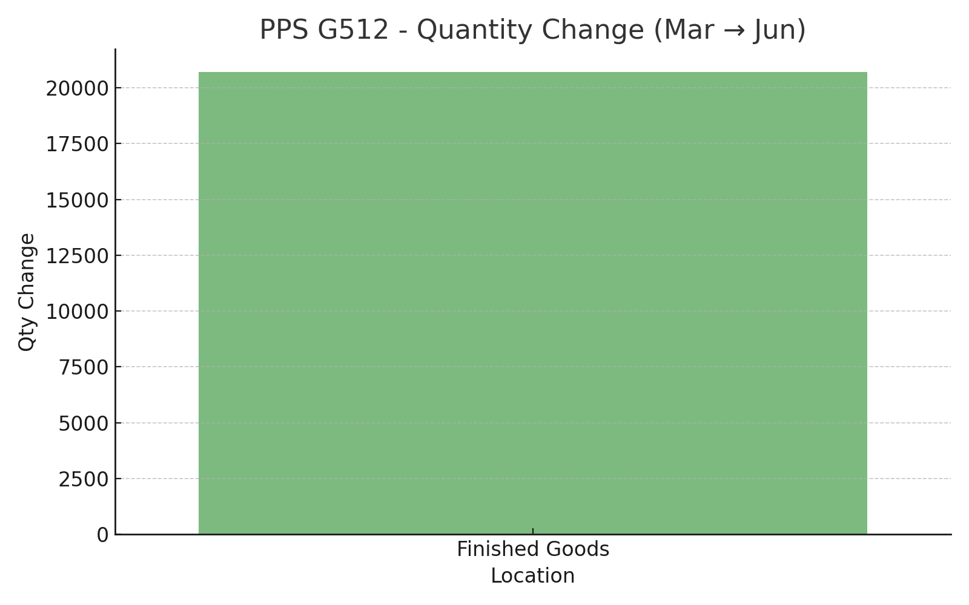
PPS G512 - Quantity Change (Mar to Jun)

Slide 4
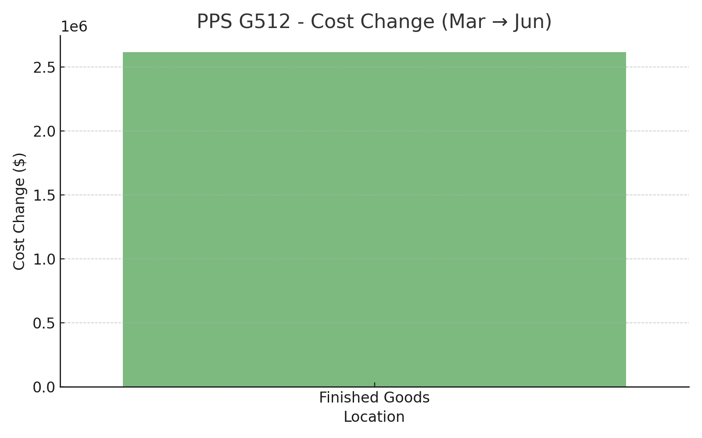
PPS G512 - Cost Change (Mar to Jun)

